Slide 1
Logic Structures
© 2022 John Sefcovic.

Slide 2
Basic Logic Structures
There are two Basic Logic Structures used in the rungs or networks.
Series Circuit
Parallel Circuit
These two circuits can be used in many variations to create the logic Structures for the PLC application.
The following Logic Structures instructions are shown in the Siemens software. The same Circuits act the same in Studio 5000 but are displayed differently.

Slide 3
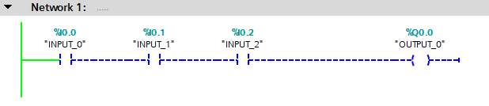
Series Circuit
In a Series Circuit the Inputs are connected in a “straight line” one connection to the next connection.
This circuit is also called an AND circuit.

Slide 4
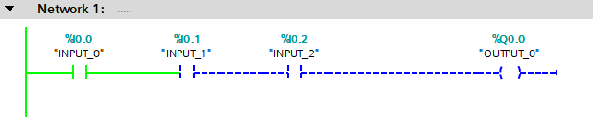
Series Circuit
In a Series Circuit the Inputs are connected in a “straight line” one connection to the next connection to the Output.
INPUT_0 is TRUE

Slide 5
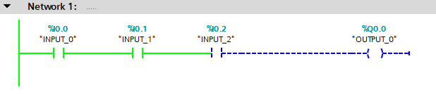
Series Circuit
In a Series Circuit the Inputs are connected in a “straight line” one connection to the next connection to the Output.
INPUT_0 is TRUE
AND INPUT_1 is TRUE

Slide 6
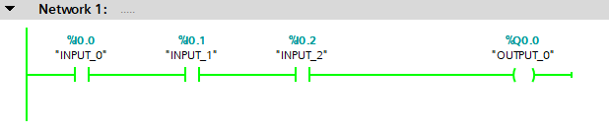
Series Circuit
In a Series Circuit the Inputs are connected in a “straight line” one connection to the next connection to the Output.
OUTPUT_0 is TRUE
INPUT_0 is TRUE
AND INPUT_1 is TRUE
AND INPUT_2 is TRUE
A complete Left to Right Path of TRUE Input instructions has established Logic Continuity making the Output TRUE.

Slide 7
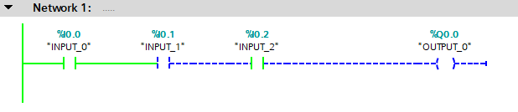
Series Circuit
In a Series Circuit the Inputs are connected in a “straight line” one connection to the next connection to the Output.
OUTPUT_0 is FALSE
AND INPUT_1 is FALSE
If any Input is FALSE, the Logic Continuity is broken, and the Output goes FALSE.
Notice INPUT_2 is TRUE, but the FALSE INPUT_1 prevents Logic Continuity to OUTPUT_0.

Slide 8
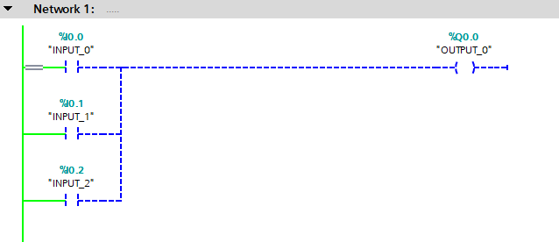
Parallel Circuit
In a Parallel Circuit the Inputs are connected “in different” paths to the Output.
This circuit is also called an OR circuit.
To create a Parallel Circuit a “Branching” structure is used.

Slide 9
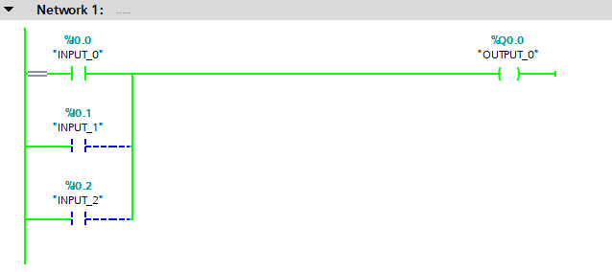
Parallel Circuit
In a Parallel Circuit the Inputs are connected “in different” paths to the Output.
OUTPUT_0 is TRUE
INPUT_0 is TRUE

Slide 10
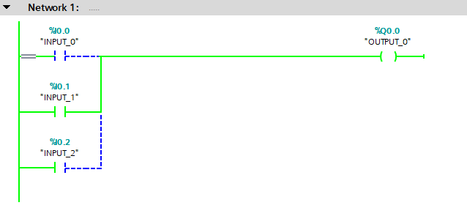
Parallel Circuit
In a Parallel Circuit the Inputs are connected “in different” paths to the Output.
OUTPUT_0 is TRUE
OR INPUT_1 is TRUE

Slide 11
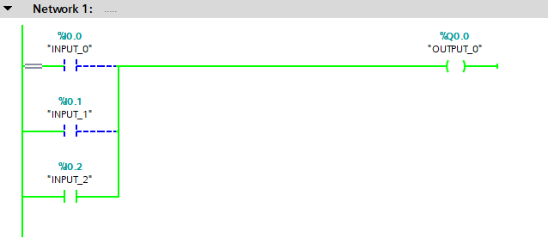
Parallel Circuit
In a Parallel Circuit the Inputs are connected “in different” paths to the Output.
OUTPUT_0 is TRUE
OR INPUT_2 is TRUE

Slide 12
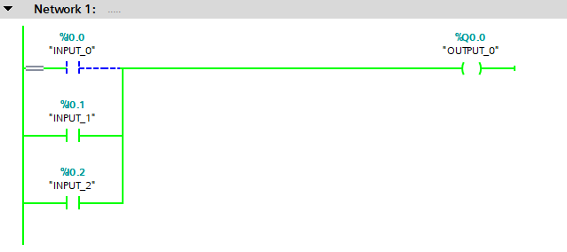
Parallel Circuit
In a Parallel Circuit the Inputs are connected “in different” paths to the Output.
OUTPUT_0 is TRUE
OR INPUT_1 is TRUE
More than one Input can be TRUE.
OR INPUT_2 is TRUE

Slide 13
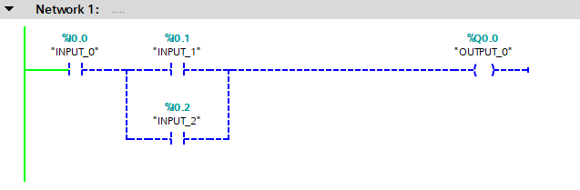
Series - Parallel Circuit
A Series – Parallel Circuit combines the two Logic Continuity paths.
The Paralleled INPUT_2 is in a “Branching” structure.

Slide 14
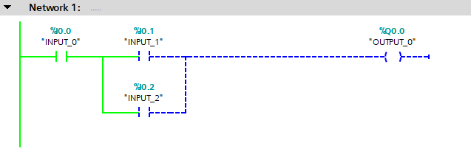
Series - Parallel Circuit
A Series – Parallel Circuit combines the two Logic Continuity paths.
INPUT_0 is TRUE

Slide 15
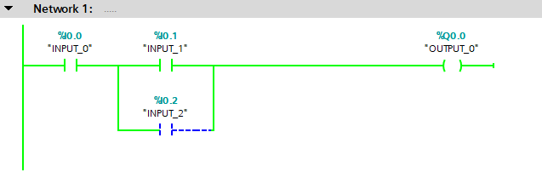
Series - Parallel Circuit
A Series – Parallel Circuit combines the two Logic Continuity paths.
AND INPUT_1 is TRUE
OUTPUT_0 is TRUE
INPUT_0 is TRUE

Slide 16
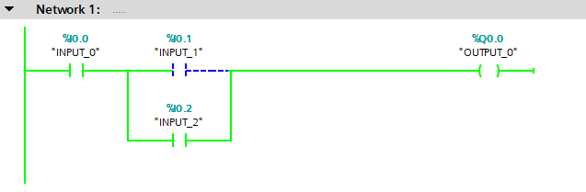
Series - Parallel Circuit
A Series – Parallel Circuit combines the two Logic Continuity paths.
OUTPUT_0 is TRUE
INPUT_0 is TRUE
OR INPUT_2 is TRUE

Slide 17
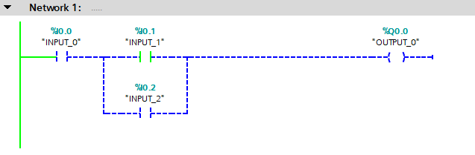
Series - Parallel Circuit
A Series – Parallel Circuit combines the two Logic Continuity paths.
AND INPUT_1 is TRUE
OUTPUT_0 is FALSE
INPUT_0 is FALSE
The FALSE INPUT_0 prevent Logic Continuity with the TRUE ANDed INPUT_1 making the OUTPUT_0 FALSE.

Slide 18
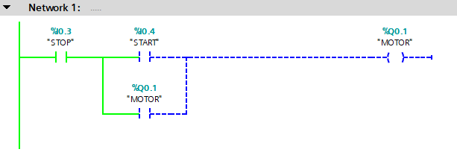
Series - Parallel Circuit Example
A Series - Parallel Circuit commonly used is a Holding Circuit.
To turn On the MOTOR output a START –STOP momentary pushbutton circuit is used.
To keep the MOTOR On when the START pushbutton is released the MOTOR Output is OR’d with START to create an alternative Logic Continuity Path to “HOLD” the MOTOR On.

Slide 19
Series - Parallel Circuit Example
The STOP is ANDed with the START.

Slide 20
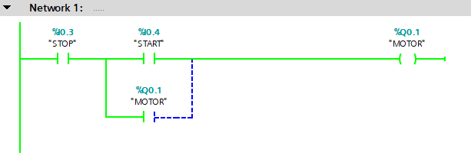
Series - Parallel Circuit Example
The START pushbutton is pressed making the START TRUE with the ANDed TRUE STOP and turns On the MOTOR.
Note: you will not see this branch being False, the circuit is completed instantaneously.

Slide 21
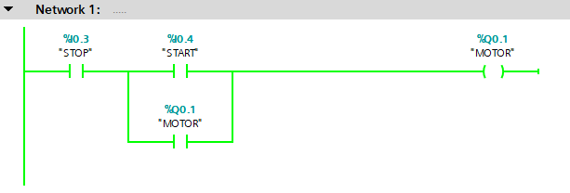
Series - Parallel Circuit Example
The TRUE OR’d MOTOR creates an alternative Logic Continuity path.
Notice the Input instruction is addressed to the MOTOR Tag.

Slide 22
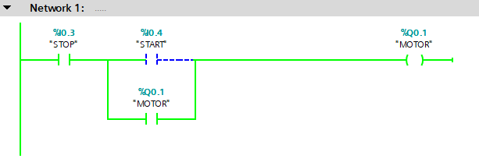
Series - Parallel Circuit Example
When the START pushbutton is released, FALSE, the alternative Logic Continuity path “Holds” the MOTOR On.
That is, the MOTOR is holding itself On.

Slide 23
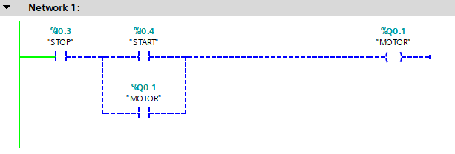
Series - Parallel Circuit Example
When the STOP pushbutton is pressed, FALSE, the ANDed circuit is broken, and the MOTOR is turned Off.
The MOTOR Tag is FALSE, and the Input uses the same Tag Data making the Input FALSE.

Slide 24
Series - Parallel Circuit Example
Releasing the STOP pushbutton returns the circuit back to the original conditions.

Slide 25
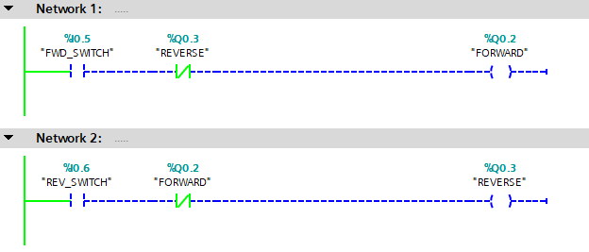
Series Circuit Interlock Example
An Interlock Circuit is commonly used to prevent two opposing inputs from being On at the same time.
It is inconsistent to command both FORWARD and REVERSE to be On at the same time.

Slide 26
Series Circuit Interlock Example
An Interlock Circuit is commonly used to prevent two opposing inputs from being On at the same time.
Notice the Output Tag is assigned as the Input instruction Tag.

Slide 27
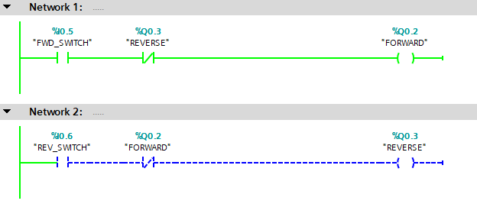
Series Circuit Interlock Example
When the FORWARD Output is On, the Input instruction assigned to FORWARD Data Tag is FALSE.

Slide 28
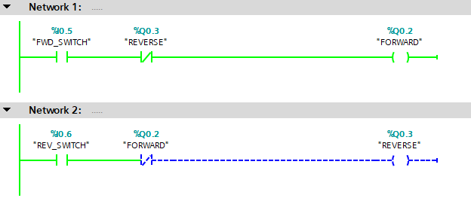
Series Circuit Interlock Example
If REVERSE is commanded to be On at the same time Forward is On, the FALSE FORWARD Input instruction prevents Reverse from turning On.
FALSE FORWARD Instruction

Slide 29
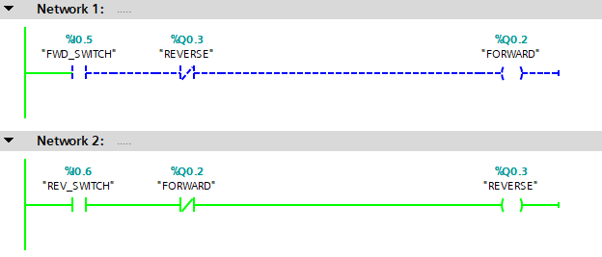
Series Circuit Interlock Example
When the REVERSE Output is On, the Input instruction assigned to REVERSE Data Tag is FALSE.

Slide 30
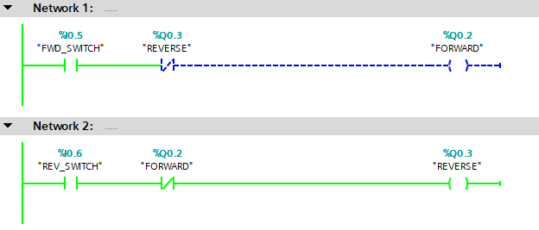
Series Circuit Interlock Example
If FORWARD is commanded to be On at the same time Reverse is On, the FALSE REVERSE Input instruction prevents Forward from turning On.

Slide 31
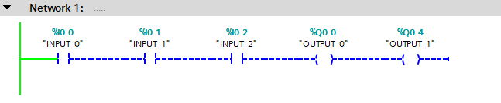
Multiple Output Example
Multiple Output instructions can be in a Series structure.

Slide 32
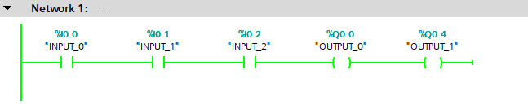
Multiple Output Example
When the Input instructions provide a complete left to right path of Logic Continuity the Outputs are TRUE.

Slide 33
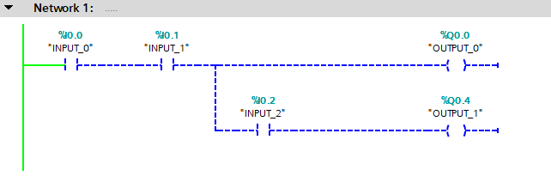
Multiple Output Example
Multiple Output instructions can be in a Parallel structure.
Input instructions may be included on the Output Branches.

Slide 34
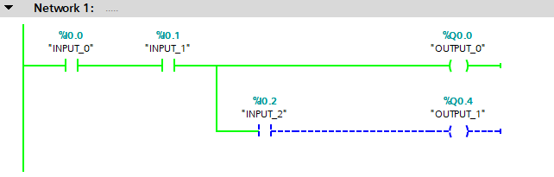
Multiple Output Example
When the Input instructions provide a complete left to right path of Logic Continuity the OUTPUT_0 is TRUE.
Because INPUT_2 is FALSE OUTPUT_1 remains Off.

Slide 35
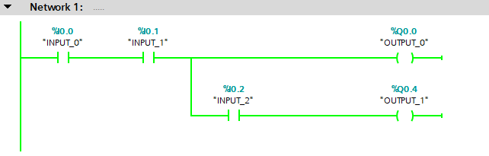
Multiple Output Example
When INPUT_2 is TRUE OUTPUT_1 turns On.

Slide 36
Multiple Output Example
The Input Conditions for OUTPUT_0 is INPUT_0 and INPUT_1.

Slide 37
Multiple Output Example
The Input Conditions for OUTPUT_1 is the same INPUT_0 and INPUT_1 and additionally INPUT_2.

Slide 38
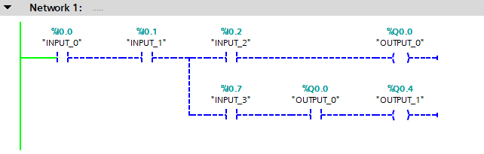
Multiple Output Example
For this circuit, OUTPUT_0 and OUTPUT_1…
…require INPUT_0 and INPUT_1 to be TRUE.

Slide 39
Multiple Output Example
OUTPUT_0 also requires INPUT_2 to be TRUE.

Slide 40
Multiple Output Example
OUTPUT_1 also requires INPUT_3 to be TRUE…

Slide 41
Multiple Output Example
OUTPUT_1 also requires INPUT_3 to be TRUE…
… and OUTPUT_0 to be TRUE.

Slide 42
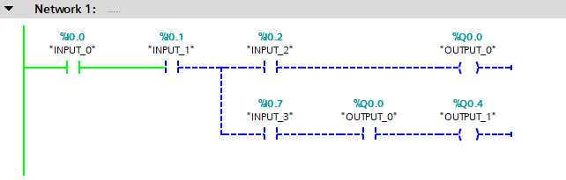
Multiple Output Example
For OUTPUT_0 to turn On.
INPUT_0 is TRUE

Slide 43
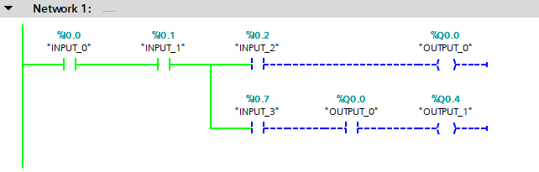
Multiple Output Example
For OUTPUT_0 to turn On.
INPUT_0 is TRUE
AND INPUT_1 is TRUE

Slide 44
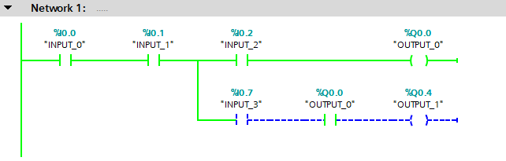
Multiple Output Example
For OUTPUT_0 to turn On.
INPUT_0 is TRUE
AND INPUT_2 is TRUE
AND INPUT_1 is TRUE

Slide 45
Multiple Output Example
INPUT_0 is TRUE
AND INPUT_2 is TRUE
OUTPUT_0 is TRUE
AND INPUT_1 is TRUE
For OUTPUT_1 to turn On.

Slide 46
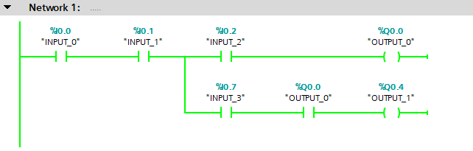
Multiple Output Example
INPUT_0 is TRUE
AND INPUT_2 is TRUE
OUTPUT_0 is TRUE
AND INPUT_1 is TRUE
AND INPUT_3 is TRUE
For OUTPUT_1 to turn On.

Slide 47
Rules
Input instructions Read the Data Tag. Input instructions may be assigned Output Tag Data.
Output instructions Write to the Data Tag. An Output instruction cannot be assigned Input Tag Data.
Series (AND) Circuit must have all instructions in the circuit be TRUE to have Logic Continuity.
Parallel (OR) Circuit may have any instruction be TRUE to have Logic Continuity.
A Parallel Circuit is created by using a Branching Structure.
Multiple Outputs instructions can be used in a Series or Parallel Structures.
Output branches may contain Input instructions.

